Slide 1
Test Driven Development

Slide 2
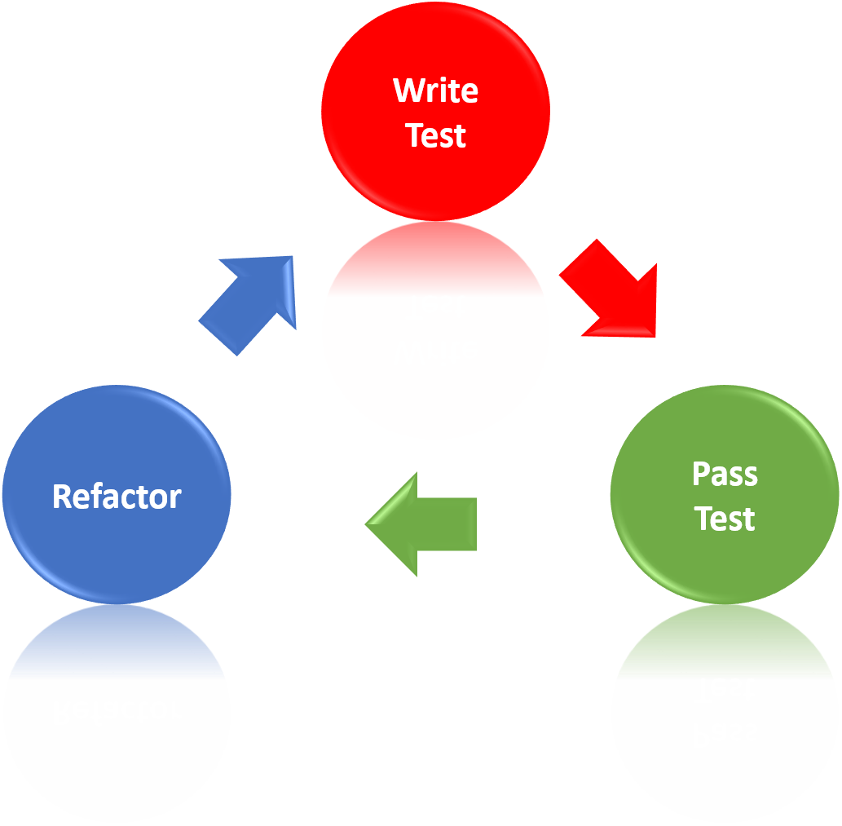
What is Test Driven Development?

Slide 3
What is Test Driven Development?
TDD is primarily here to ensure code is functionally perfect. Concrete:
All code is tested: Gets rid of typos and logic errors the developer may have made.
Bugs are first reproduced as tests: Prevents regression later on, quality improves continuously
Plays into design and collaboration, more on that later
Tech agnostic, the practice is always the same
You can do hardware development with TDD if you really want
It does not get rid of testers
The main point of testers is to have someone else identify bugs / problems
Notes:
Bugs not covered by TDD: Wrong understanding of dev, unknown edge cases
BEFORE going forward: 3 minutes of searching the “why”

Slide 4
Why Test Driven Development?
Why are developers interested in TDD?
No new code can be added without a test covering it. 100% branch coverage is reached by default, providing a robust and fast test harness.
Bugs are fixed by first writing tests, thus preventing regression in the future. No longer will fixing one bug lead to another bug popping up!
Code written is designed for testability since the first consumer is a test. Expect to see design changes so that mocks are only necessary in special cases.
As developers learn to think in units and become more proficient with refactorings big chunks are split into smaller units as they approach a threshold.
You can read the tests to understand how a feature is used. Instead of reading documentation you now have always working examples ready to use.

Slide 5
Why Test Driven Development?
Why are stakeholders interested in TDD?
Technical debt (legacy code) slows down development
Bugs are expensive and interrupt a team!
A wary developer is an unhappy developer
Technical excellence can’t be fixed “from above”

Slide 6
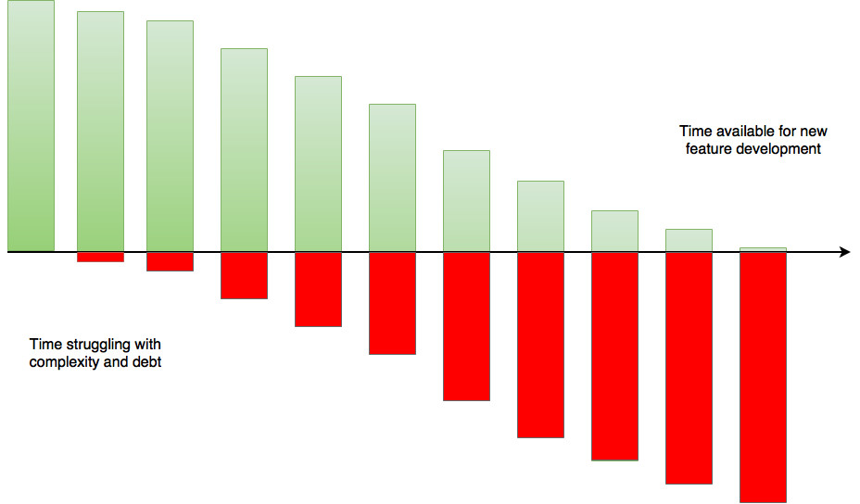
Why Test Driven Development?
Technical Debt
Notes:
The red part is INVISIBLE
Myth about 50/50 split: Every interruption causes you to lose time
Note: Not only legacy code is technical debt – also wrong architecture / tool decisions for example
Anecdote: Everybody is very busy, but development does not really move forward a lot: Feature development is slow and a lot of builds are rejected in QA. There are mounting tensions between PMs, Developers and Testers.

Slide 7
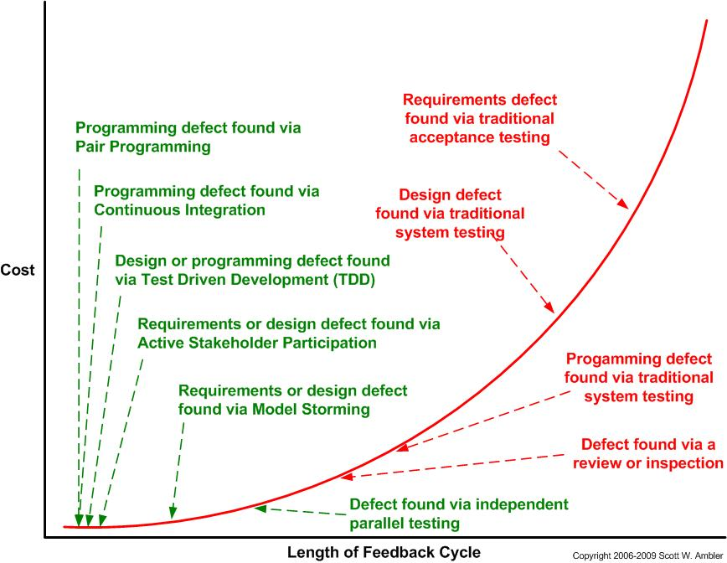
Why Test Driven Development?
Cost of errors
Notes:
Pay special attention to the red parts, go through one by one
http://www.agilemodeling.com/essays/costOfChange.htm
Model Storming: Modelling JIT, grab a few colleagues

Slide 8
Why Test Driven Development?
Common excuses and why they don’t hold
“Don’t know about JUnit-like testing frameworks”
“Too much effort needed, don’t have the time for it”
“Initial set-up for unit testing is too complex/slow”
“The effort to change the code AND the unit tests is too big when changes occur”
“Unit tests are too complex to write for our application”
“I don’t need unit tests, my code is OK”
“I don’t know what result to expect”
“Out of laziness”
“It has worked before”
Notes:
Problems with those testing techniques:
- hard to reproduce
- feasible only for bigger units -> at a later development stage
How is (Unit) Testing handled now?
What are the
- problems
- expenses in time
- stakeholders, who wants to find errors?
- complexity of testing
- amount of test cases
- effort of keeping tests up to date

Slide 9
How to do Test Driven Development?
Write the next simplest test you can think of. See it fail.
Write the simplest implementation you can think of. You are not allowed to go below 100% branch coverage! See test pass.
Refactor until you are satisfied with the code quality. Refactoring means no functional code changes. Verify this by running the tests again and checking code coverage.

Slide 10
Your exercise: Build a bowling screen
Originally from Uncle Bob
Adapted for Go by me
Write a module named “game” that has two methods
roll(pins : int) is called each time the player rolls a ball. The argument is the number of pins knocked down.
score() : int is called throughout the game. It returns the total score for that game.

Slide 11
Scoring Bowling.
The game consists of 10 frames as shown above. In each frame the player has
two opportunities to knock down 10 pins. The score for the frame is the total
number of pins knocked down, plus bonuses for strikes and spares.
A spare is when the player knocks down all 10 pins in two tries. The bonus for
that frame is the number of pins knocked down by the next roll. So in frame 3
above, the score is 10 (the total number knocked down) plus a bonus of 5 (the
number of pins knocked down on the next roll.)
A strike is when the player knocks down all 10 pins on his first try. The bonus
for that frame is the value of the next two balls rolled.
In the tenth frame a player who rolls a spare or strike is allowed to roll the extra
balls to complete the frame. However no more than three balls can be rolled in
tenth frame.
Notes:
5 Tests:
1. Score is 0
2. Roll no spares / strikes, score is roll(s)
3. Roll spare (introduce frame)
4. Roll strike
5. Full game for 10th frame

